Slide 1
Extrapolating a sequence
Non-linear relationships

Slide 2
how to use Oak lessons

Slide 3
I can appreciate that there are other number sequences and the limitations of only seeing a few terms of a sequence.

Slide 4
An arithmetic (or linear) sequence is a sequence where the difference between successive terms is constant.
A geometric sequence is a sequence with a constant multiplicative relationship between successive terms.

Slide 5

Extrapolating a sequence
Other sequences
Extrapolating a sequence

Slide 6



Other sequences
I’m writing a sequence which follows a rule. Here are the first four terms: 3, 5, 7, 9, …
That’s easy, it’s a linear sequence so the next term is 11.
Alex
Actually it’s the odd numbers not containing the digit 1
Sofia
What do you think the next term is going to be?
What are the next 3 numbers in Alex’ sequence?
23, 25, 27, …

Slide 7
Other sequences
My turn! I’m going to start my sequence 2, 3, 5, …
What rules or patterns can you think of for Sofia’s sequence? What would the next term be?
Sofia
Good guesses, I was going for prime numbers but I like all of these ideas.
Some suggestions:
Add 1, add 2, add 3, …. Next terms would be 8 and 12.
Add two previous terms to get next term. Next terms are 8 and 13.
Prime numbers in ascending order. Next terms are 7 and 11.
Double and subtract 1. Next terms are 9 and 17.

Slide 8
Other sequences
Some rules for numerical sequences only work in a certain language.
Can you work out where this sequence of numbers comes from?
3, 3, 5, 4, 4, 3, 5, 5, 4,....
Hint: write the numbers 1-9 out in English
It’s the number of letters in the integers greater than zero (in numerical order)
‘One’ has 3 letters
‘Two’ has 3 letters
‘Three’ has 5 letters…
Although there are possibly other things which give the same values!

Slide 9
Other sequences
Geometric sequences have a common ratio between successive terms.
Arithmetic sequences have a common difference between successive terms
I wonder what will happen if we combine these ideas?
Alex
If we start with a 1st term of 1 then double and add 1, the next term will be 3.
What are the next three terms?
1, 3, 7, 15, 31, …
Can you spot any patterns in this sequence?

Slide 10


Other sequences
Can you spot any patterns in this sequence?
1, 3, 7, 15, 31, ….
That’s interesting the differences between successive terms form a geometric sequence….
+2
+4
+8
+16
+32
×2
×2
×2
×2
Andeep
Can you find two ways to calculate the next term?
31 × 2 + 1 = 63
31 + 32 = 63
Can you generate another sequence where the differences form a geometric sequence?

Slide 11
Other sequences
Can you generate another sequence where the differences form a geometric sequence?
Geometric sequences themselves have this feature
5, 15, 45, 135, …
Or other sequences where the term-to-term rule has a multiplicative and additive step
2, 4, 10, 28
+10
+30
+90
+2
+6
+18
×3
×3
×3
×3
term-to-term rule ‘times 3 subtract 2’

Slide 12

Other sequences
Here are some numerical sequences and rules. Which rule could be a rule for each sequence, match them up?
a
1, 2, 5, 14, 41, …
Add the two previous terms to get the next term
Times 1, times 2, times 3, times 4, ……
b
1, 2, 3, 5, 8, …
Add 1, times 1, add 2, times 2, add 3, times 3, ……
c
3, 4, 4, 7, 10, …
Treble the previous term and subtract 1 to get the next term
d
1, 2, 2, 4, 8, …
The number of letters in the english spelling of the square numbers (in ascending order)
e
1, 1, 2, 6, 24, …

Slide 13
Other sequences
1) For each of the starting two terms, continue the sequence in three different ways. Explain the rule you have used for each way.
2, 6, , , , …
−1, 5, , , , …
8, 3, , , , …
11, 13, , , , …

Slide 14
Other sequences
2) For each of these sequences, suggest what the next two terms might be. Explain your reasoning.
2, 3, 8, , , …
31, 29, 31, , , …
3, 20, 190, , , …
2, 4, 16, , , …
8, 5, 4, 9, , , …

Slide 15
Other sequences
1) For each of the starting two terms, continue the sequence in three different ways. Explain the rule you have used for each way.
Many answers for each question, these are just some ideas.
2, 6, , , , …
−1, 5, , , , …
E.g. 2, 6, 18, 54, 162 (common multiplier of ×3 between terms)
2, 6, 10, 14, 18, … (common difference of +4 between terms)
2, 6, 12, 20, 10, … (add 4, add 6, add 8,... Common second difference +2)
E.g. −1, 5, −25, 125, −625 (common multiplier of ×−5 between terms)
−1, 5, 4, 9, 13 (add two previous terms to get the next term)

Slide 16
Other sequences
1) For each of the starting two terms, continue the sequence in three different ways. Explain the rule you have used for each way.
Many answers for each question, these are some ideas.
8, 3, , , , …
11, 13, , , , …
E.g. 8, 3, −1, −4, −6 (add −5, add −4, add −3, Common second difference +1)
8, 3, −2, −7, −12, … (common difference of +(−5) between terms)
E.g. 11, 13, 15, 17, 19, … (common difference of +2 between terms)
11, 13, 17, 19, 23 (Prime numbers greater than 10)
11, 13, 16, 20, 35 (Triangular numbers add 10)

Slide 17
Other sequences
2) For each of these sequences, suggest what the next two terms might be. Explain your reasoning.
There are several answers for each question. One suggestion is given for each.
2, 3, 8, 17, 30, …
31, 29, 31, 29, 31, …
3, 20, 190, 1890, 18890, …
2, 4, 16, 256, 65536, …
8, 5, 4, 9, 6, 5, …
Add 1, add 5, add 9, common second difference +4
Sequence oscillating between 31 and 29
Add 17, add 170, add 1700, difference is multiplied by 10 each time.
Previous term squared gives the next term
Subtract 3, subtract 1, add 5, in a repeating pattern.

Slide 18
Extrapolating a sequence
Other sequences
Extrapolating a sequence

Slide 19
Extrapolating a sequence
We have seen sequences that start on the same values but follow different rules.
It is possible for a rule to look like it works for a certain number of terms and then fail for following terms.
What do you think?
How many terms in a sequence do we need, to be able to work the rule out for sure?
We are going to explore this now.
Sofia

Slide 20
Extrapolating a sequence
I have found a sequence for us to try out. It starts with the number 6.
One term is not enough to determine a rule. We can apply any term-to-term rule to the number 6.
Andeep
The second term is 7.
Can we now determine a rule?
We can find rules that work for these two terms e.g. 6, 7, 8, 9, … common difference of 1.
However there are still infinite number of rules that could work. We cannot be sure we know how to generate the next term from this information.

Slide 21
Extrapolating a sequence
The third number in Andeeps sequence is 9. So his sequence so far is: 6, 7, 9,..
This cannot be an arithmetic or geometric sequence
It’s a quadratic sequence, it adds 1, then 2 so next it will add 3
Alex
Sofia
Do you agree with either statement?
Sofia is correct, there is no common difference or common ratio so these cannot be the first 3 terms in a linear or geometric sequence.
It could be quadratic however we do not know that it is definitely quadratic.

Slide 22
Extrapolating a sequence
The next term is 12 so Andeep’s sequence so far looks like 6, 7, 9, 12, …
It is quadratic then as 9 + 3 = 12
Alex
Alex’ rule so far has worked on all terms. Is that enough to say for sure what the rule is?
No, there is still no guarantee that Alex’ rule will continue working. In fact without knowing a rule we cannot assume we know how a sequence will continue even if we are given lots of terms.

Slide 23
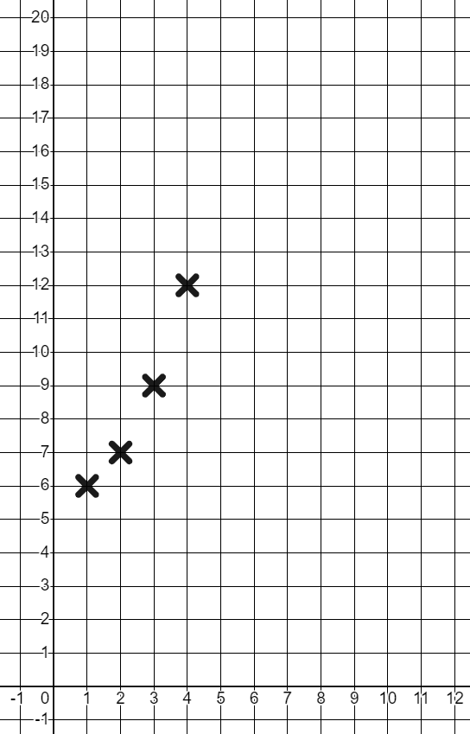
Extrapolating a sequence
These terms are actually the average day time temperatures in my home town for each month of the year. (In °C)
Temperature in °C
Andeep
Plotting them on a graph may help us see a trend.
If the first term represents the average daytime temperature in January, what do you thing the 5th term will be?
Months of the year (Jan-Dec)

Slide 24
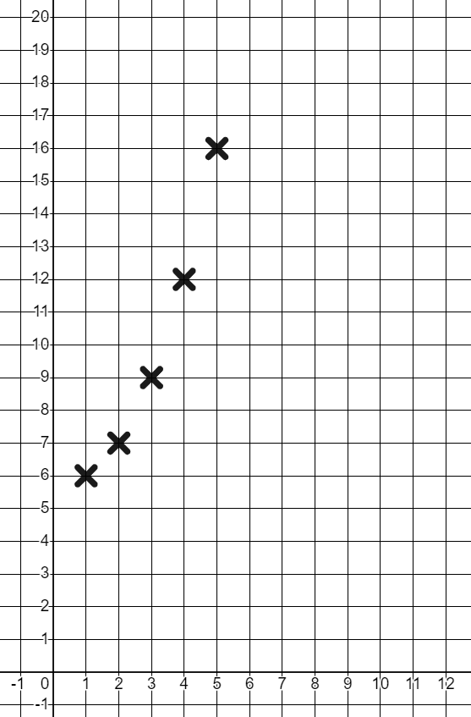
Extrapolating a sequence
We can see there is a general trend in the values. The temperatures are increasing. The rate at which they are increasing is growing. Do you think this will continue?
The next month is May, so the temperature would be expected to increase again.
In fact the average temperature in May was 16°C
This is still following my rule 12 + 4 = 16
Alex

Slide 25
Extrapolating a sequence
This can be the case with more mathematical sequences too.
For example the prime numbers greater than 2 start with
3, 5, 7,...
This looks to be an arithmetic sequence with common difference 2
However the next five terms are
3, 5, 7, 11, 13, 17, 19, 23, ….
+2
+4
+2
+4
+2
+4
There now seems to be a new pattern emerging, does this continue?
No, the next term would be 25 which is not prime.

Slide 26
Extrapolating a sequence
The table below shows the amount of money in a savings account at the end of the month.
What do you think is happening every month
What do you predict the value in the account to be at the end of December?
Months | Aug | Sept | Oct | Nov | Dec
Savings (£) | 1253 | 1443 | 1633 | 1823
£190 is being saved. Often people save the same amount each month as it is a percentage of their earnings.
We could assume this trend continues so £2013

Slide 27
Extrapolating a sequence
The table below shows the amount of money in a savings account at the end of the month.
3) The value is actually £1900. Why do you think that might be?
Months | Aug | Sept | Oct | Nov | Dec
Savings (£) | 1253 | 1443 | 1633 | 1823 | 1900
In December people often save less as they spend more around the holidays.
We cannot assume the trend will continue.

Slide 28
Extrapolating a sequence
You are going to investigate patterns found when points marked on a circle are joined with straight lines.
Every point will be joined with a straight line and sometimes this will create regions and intersections.
Points
e.g.
×
×
Lines
e.g.
×
×
Regions
e.g.
Intersections
(where two lines cross)

Slide 29
Extrapolating a sequence
You are going to investigate patterns found when points marked on a circle are joined with straight lines.
In this example there are 4 points, 6 lines, 1 intersection and 8 regions.
Points
e.g.
×
×
Lines
e.g.
×
×
Regions
e.g.
Intersections
(where two lines cross)

Slide 30
Extrapolating a sequence
Start with a circle with one point marked.
The circle itself is 1 region.
So there is 1 region.
×
As there is only one point we cannot join the points with a line. So there are 0 lines.
As there are no lines there are no points where the lines cross each other so 0 intersections.

Slide 31
Extrapolating a sequence
Now let’s look at two points.
×
×
×
Two points can be joined with a straight line. So there is 1 line.
There are no points where line cross each other so there are 0 intersections.
The line splits the circle into 2 regions.

Slide 32
Extrapolating a sequence
1) Here is a table to record what you find.
×
×
×
Number of points on the circle | 1 | 2 | 3 | 4
Number of lines | 0
Number of intersections | 0
Number of regions | 1
a) Complete the table for 2 points.
b) Fill in the table for 3 points and 4 points.
c) Describe any patterns you notice.
×
×
×
×
×
×
×

Slide 33
Extrapolating a sequence
1) Fill in this table to investigate patterns found when points around a circle are joined with straight lines.
Number of points on the circle | 1 | 2 | 3 | 4 | 5
Number of lines | 0
Number of intersections | 0
Number of regions | 1
×
d) Make a prediction for what the 5th column will look like.
e) Use the circle given to fill in the 5th column.
f) Were you correct? Have any of your patterns changed?
×
×
×
×

Slide 34
Extrapolating a sequence
1) Fill in this table to investigate patterns found when points around a circle are joined with straight lines.
Number of points on the circle | 1 | 2 | 3 | 4 | 5 | 6
Number of lines | 0
Number of intersections | 0
Number of regions | 1
×
g) Make a prediction for what the 6th column will look like.
h) Use the circle given to fill in the 6th column.
i) Were you correct? Write a sentence explaining what you have found.
×
×
×
×
×

Slide 35
Extrapolating a sequence
1) Fill in this table to investigate patterns found when points around a circle are joined with straight lines.
Number of points on the circle | 1 | 2 | 3 | 4 | 5 | 6
Number of lines | 0
Number of intersections | 0
Number of regions | 1
j) Do you think you have found any patterns which will continue? Write a sentence explaining why.

Slide 36
Extrapolating a sequence
1) Here is a table to record what you find.
×
×
×
Number of points on the circle | 1 | 2 | 3 | 4
Number of lines | 0 | 1
Number of intersections | 0 | 0
Number of regions | 1 | 2
a) Complete the table for 2 points. See table

Slide 37
Extrapolating a sequence
1)
Number of points on the circle | 1 | 2 | 3 | 4
Number of lines | 0 | 1 | 3 | 6
Number of intersections | 0 | 0 | 0 | 1
Number of regions | 1 | 2 | 4 | 8
×
×
b) Fill in the table for 3 points and 4 points.
c) Describe any patterns you notice.
3
1
4
1
2
3
2
×
×
×
5
6
×
4
7
8
×
E.g. the number of lines increases by 1, then 2, then 3, …. For term 2 onwards these are the triangular numbers.
The number of regions are the first 4 terms in a geometric sequence.

Slide 38
Extrapolating a sequence
1)
Number of points on the circle | 1 | 2 | 3 | 4 | 5
Number of lines | 0 | 1 | 3 | 6 | 10
Number of intersections | 0 | 0 | 0 | 1 | 5
Number of regions | 1 | 2 | 4 | 8 | 16
×
d) Make a prediction for what the 5th column will look like.
e) Use the circle given to fill in the 5th column.
f) Were you correct, have any of your patterns changed?
The number of lines and regions have continued in the same pattern
There are not enough terms to see a pattern with intersections
×
×
×
×

Slide 39
Extrapolating a sequence
Number of points on the circle | 1 | 2 | 3 | 4 | 5 | 6
Number of lines | 0 | 1 | 3 | 6 | 10 | 15
Number of intersections | 0 | 0 | 0 | 1 | 5 | 13
Number of regions | 1 | 2 | 4 | 8 | 16 | 30
1)
×
g) Make a prediction for what the 6th column will look like.
h) Use the circle given to fill in the 6th column.
i) Were you correct? Write a sentence explaining what you have found: Your answer may have included,
The number of regions looked geometric but this didn’t continue to pattern 6. The number of lines for pattern 2 onwards is the triangular numbers. The number of intersections could have a pattern but more terms are needed.
×
×
×
×
×

Slide 40
Extrapolating a sequence
1) Fill in this table to investigate patterns found when points around a circle are joined with straight lines.
Number of points on the circle | 1 | 2 | 3 | 4 | 5 | 6
Number of lines | 0 | 1 | 3 | 6 | 10 | 15
Number of intersections | 0 | 0 | 0 | 1 | 5 | 13
Number of regions | 1 | 2 | 4 | 8 | 16 | 30
j) Do you think you have found any patterns which will continue? Write a sentence explaining why.
The number of lines will continue to be the triangular numbers as every point is joined to every other point. The triangular number sequence is the same as the number of connections between 2, 3, 4, 5, … objects. It is unclear how the other two patterns will continue at this stage.

Slide 41
Extrapolating a sequence
Not all numerical sequences follow a mathematical rule.
A numerical sequence is just a set of numbers written in an order.
If you only know a few terms in a sequence, it is possible that the sequence can continue in multiple ways.
Even if a pattern applies to many terms, there is no guarantee that will continue.
Finding patterns can help you make predictions but these are not always correct.

Slide 42

© Oak National Academy 2024.
Produced in partnership with Mathematics in Education and Industry.
Licensed on the Open Government Licence v3.0, except where otherwise stated. See Oak terms and conditions.

